Slide 1
Historical evidence Images of Jesus – Who was he? Teacher/Liberator
Miracles Crucifixion and resurrection
Belief/opinion/fact /Faith
Truth vs things being True
Perception/illusion
What does it mean to be religious?
Philosophy
What and how do we know?
How can we know?
Belief in God
Evil and Suffering
The Afterlife
The Soul
Jesus the man (historical)/Jesus the son of God
Denominations.
Did God create the universe? Arguments for and against. Cosmological Teleological
Evidence Sacred books
Do we have a soul?
What is it?
Where is it?
Body and Soul – separate or joined?
If God exists why is there suffering? Atheist vs religious views
Theodicies – soul making, original sin, Freewill
Is there any life after death?
Heaven and Hell
Reincarnation (Hinduism)
Ghosts (?)
Year 7

Slide 2
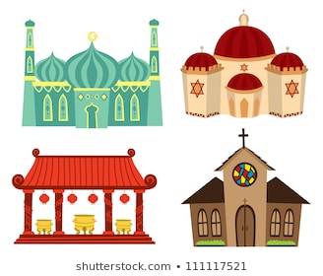
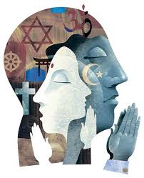
Islamaphobia
Prejudice and discrimination Human Rights
The Island
Rules and Sacred Books
Is there one basic rule for living?
10 Commandments/5 pillars/5 Precepts
Where do rules come from? Holy Books
When identities clash
Religious Food and Festivals
Kosher
Halal
Celebratory meals
Stories behind festivals and their importance and impact
Identity and Belonging
Are all places of worship the same? Worship – styles and spaces Pilgrimage - Hajj
Sacred Places
Practices and ceremonies
What are the stages of your life going to be? Rites of passage Religious and secular (including World views) – Initiation Weddings
Religious Dress
Symbols
How important are symbols? 5Ks of Sikhism
Purdah
Tefillin and orthodoxy
Amish
Year 8
Theology/Religions

Slide 3
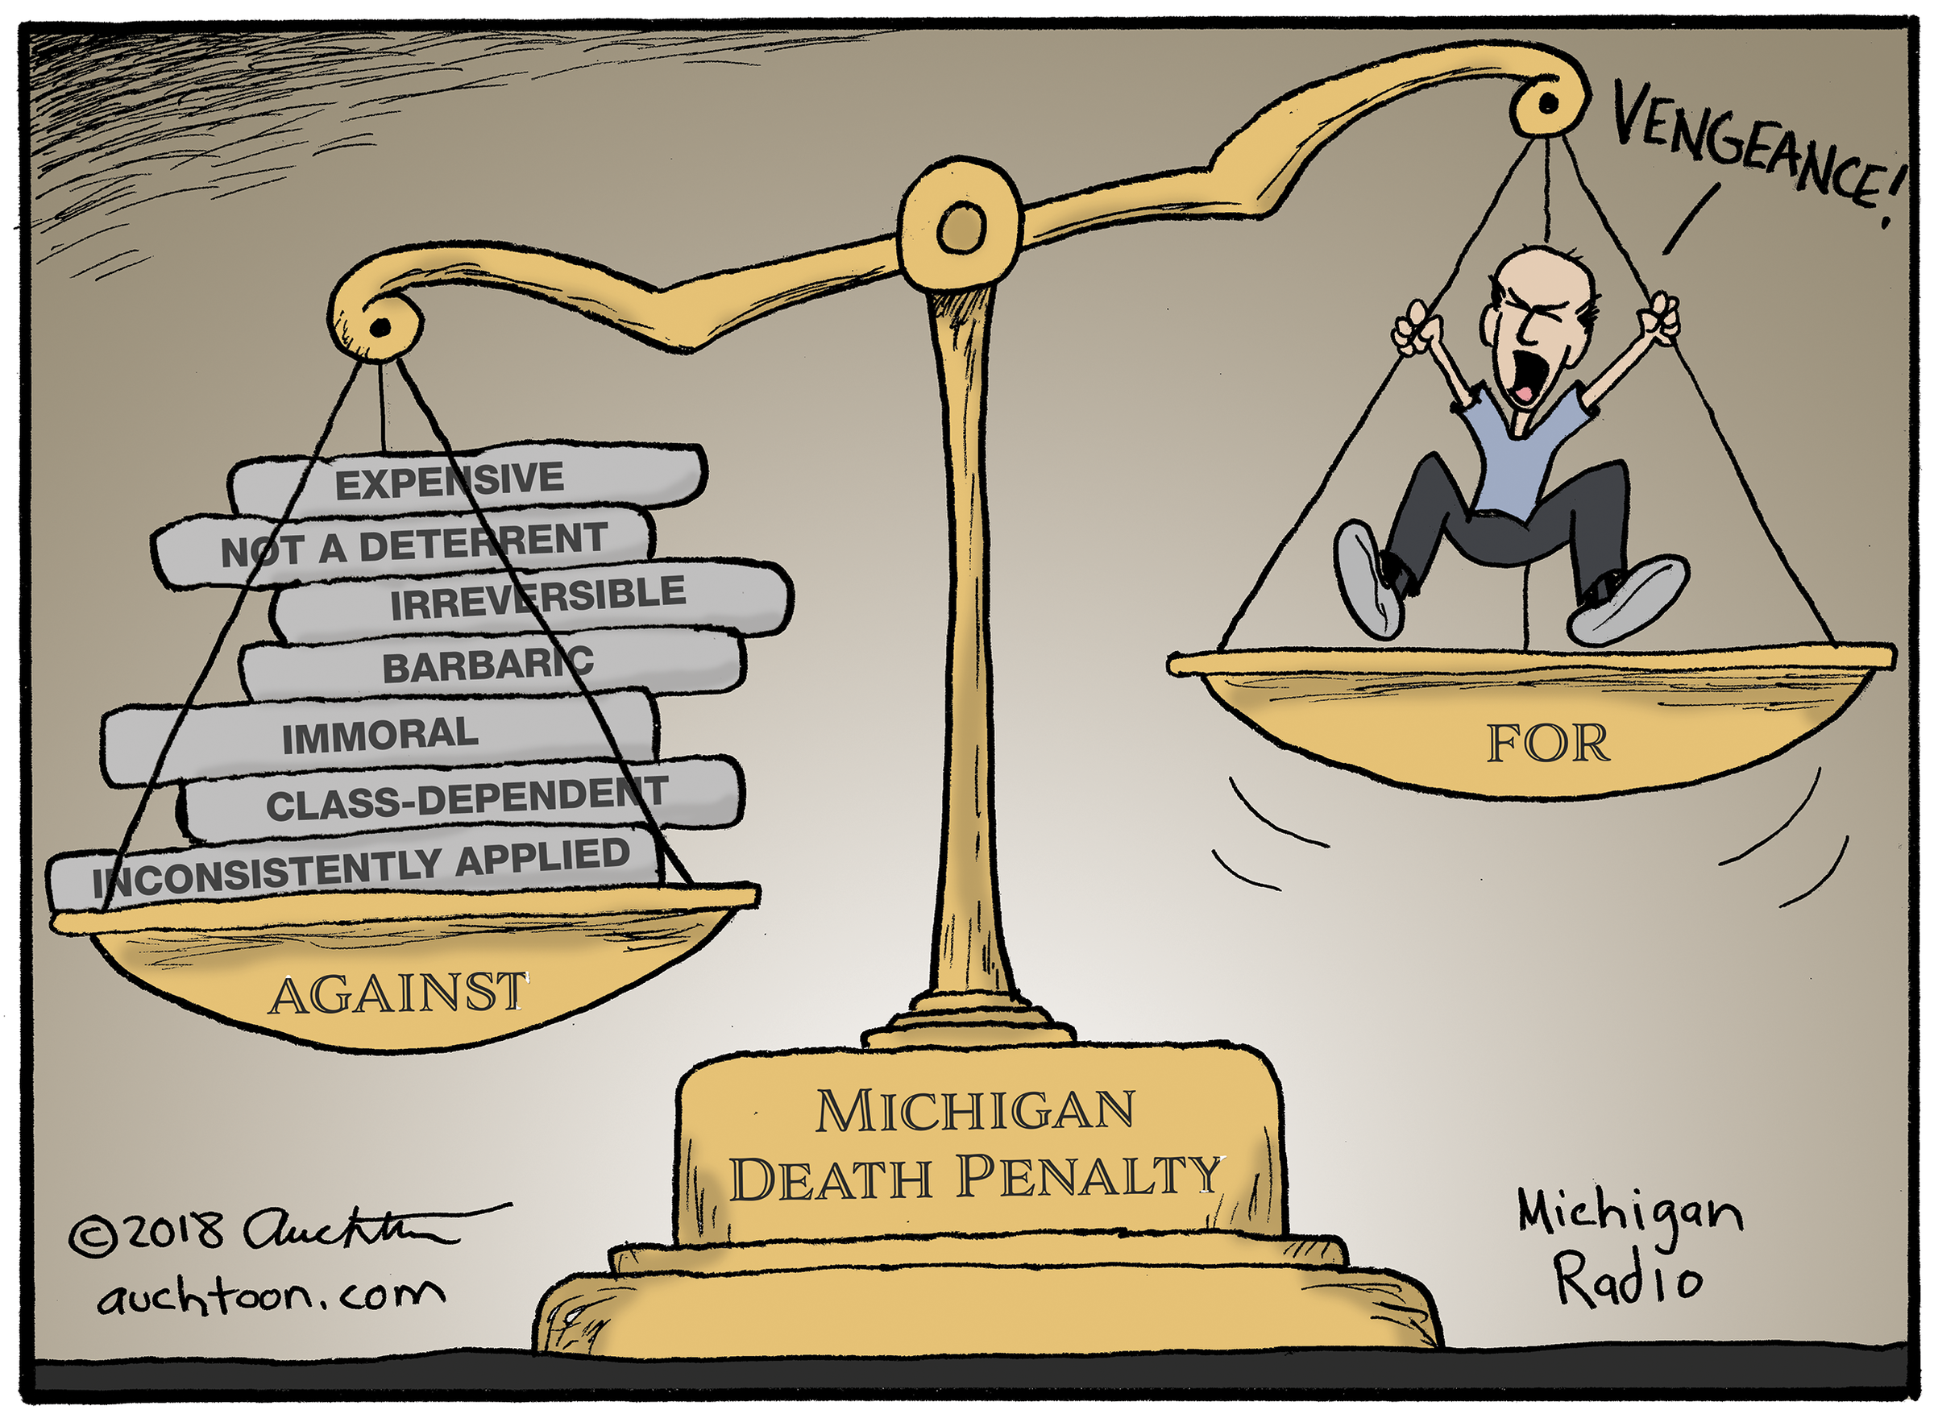
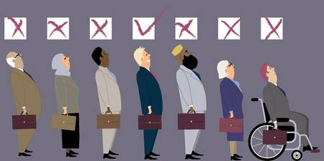
Causes of crime
Aims of punishment
Forgiveness
Types of punishment
Prison
Capital
Corporal
Religious views – Christian and Buddhist
THEMES AQA A
Crime and Punishment
Human Rights and Social Justice
Peace and Conflict
Reasons for war, including greed, self-defence and retaliation.
The just war theory, including the criteria for a just war.
Holy war
Violence
WMDs
Pacifism
Religion and belief as a cause of war and violence in the contemporary world
Human rights
Discrimination and Prejudice
Sexism/racism/Homophobia
equality, freedom of religion and belief including freedom of religious expression.
Wealth and Poverty incl. exploitation
Year 9
GCSE
AQA
Ethics/Human Social Sciences

