Slide 1
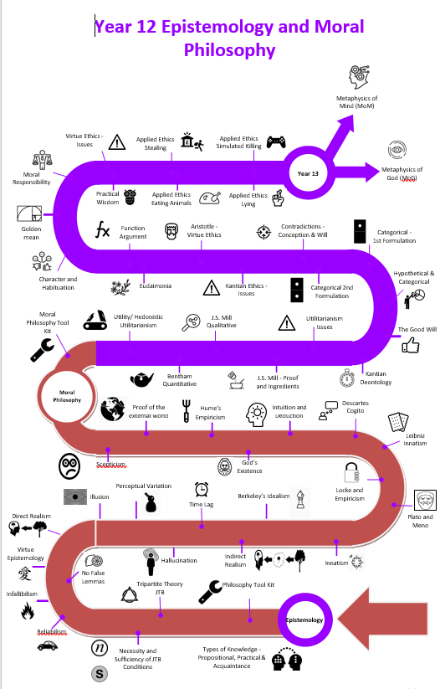
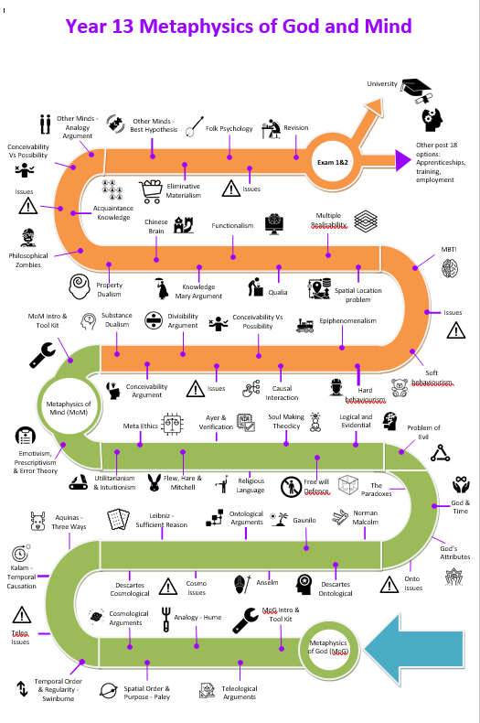
AQA
A Level Philosophy
Learning Journey

Slide 3
Epistemology
What is knowledge?
Perception as a source of knowledge
Reason as a source of knowledge
The limits of knowledge

Slide 5
Normative ethics
Utilitarianism
Applied Ethics
stealing
Meta-ethics
Moral Realism
Moral Philosophy
Kantian
Virtue
simulated killing (within computer games, plays, films etc)
eating animals
telling lies.
Moral anti Realism

Slide 7
Metaphysics of God
The concept and nature of 'God’
Arguments relating to the existence of God
Cosmological
Religious language
Teleological/design arguments
Ontological
The Problem of Evil

Slide 9
Metaphysics of Mind
What do we mean by ‘mind’?
Dualist theories
Physicalist theories
Functionalism

